Slide 1
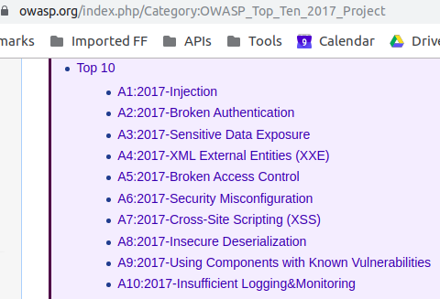
OWASP Top 10 Vulnerabilities

Slide 2
Threat Model- XSRF

Slide 3
What is XSRF / CSRF
X-site Request Forgery
Demo1 https://youtu.be/6TsjwC-AYc0
Demo2 https://youtu.be/5joX1skQtVE
How to prevent ?
XSRF Token
Server side transaction handling

Slide 4
Insecure Direct Object Reference (IDOR) Attack
Information Disclosure
Insufficient Authorization Checks
Demo https://youtu.be/TRDyvgkBcUs

Slide 5
XXE attack
Demo https://youtu.be/1l9erhtZt00
Also called Billion Laugh (Lol;) Attack https://en.wikipedia.org/wiki/Billion_laughs_attack
YAML also has similar vulnerability
How to prevent?
SAST tool might help
Awareness about parser/DTD

Slide 6
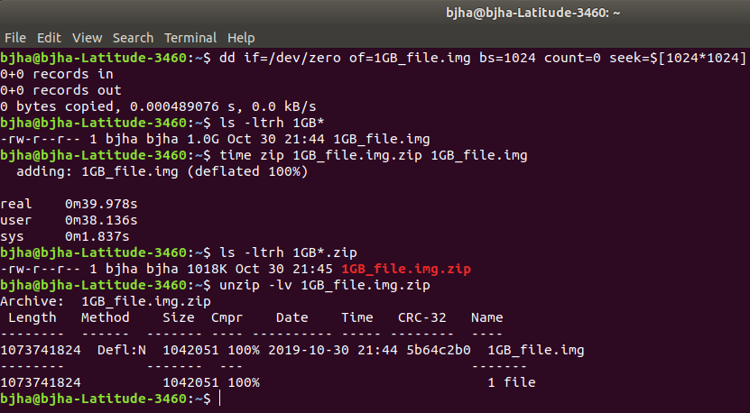
Zip Bomb Attack

Slide 7
Security Misconfiguration
Path traversal attack https://youtu.be/L95M0F55Fp0
AWS demo: https://youtu.be/5joX1skQtVE
Lessons?
Information disclosure
DoS
Reputation loss etc

